Slide 1
REPLICATION REPORT
Compulsory Licensing and Domestic Innovation
A Critical Re-examination of Moser and Voena (2012)
Lucas Simatovic, Betsy Laines, Khadijatou Loum
16 January 2026

Slide 2
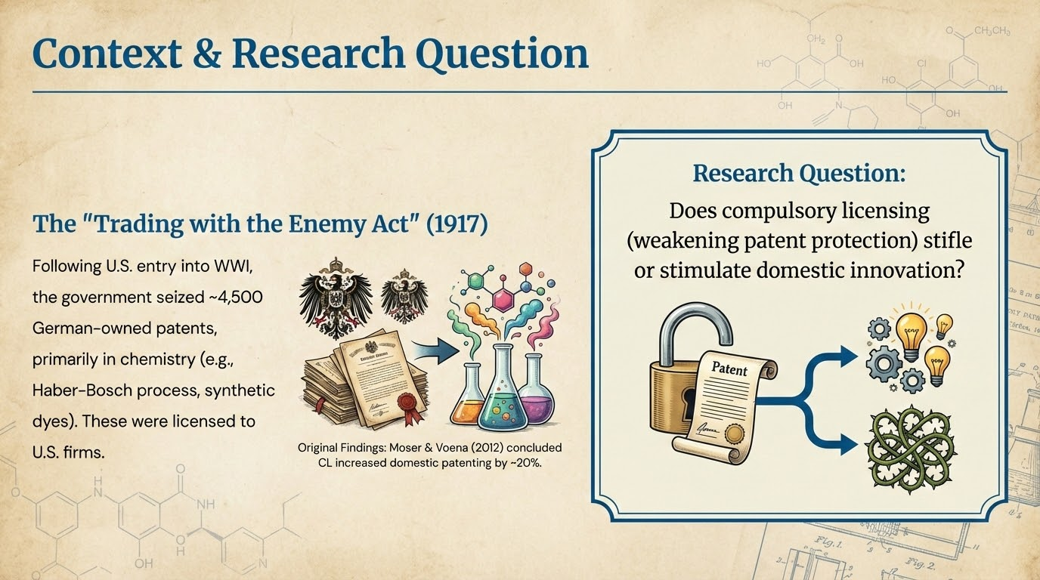

Slide 3





Data Description
Availability & Completeness
Unit of Analysis
Descriptive Statistics
USPTO Subclass: Represents specific tech areas (Azo dyes).
Pre-1918 Differences:
Source: AER Replication Package & ICPSR.
Domestic Patents: Treated subclasses had fewer (0.13 vs 0.31).
•
Dataset: ~130,000 chemical inventions (1875-1939).
Treatment Group: 336 subclasses with at least one licensed German patent.
Control Group: 6,912 chemical subclasses without licensed enemy patents.
•
German Share: Treated subclasses were heavily reliant on German tech (17% vs 2%).
Issue: Raw patent-level data is missing; package starts at aggregated subclass-year level.

Slide 4
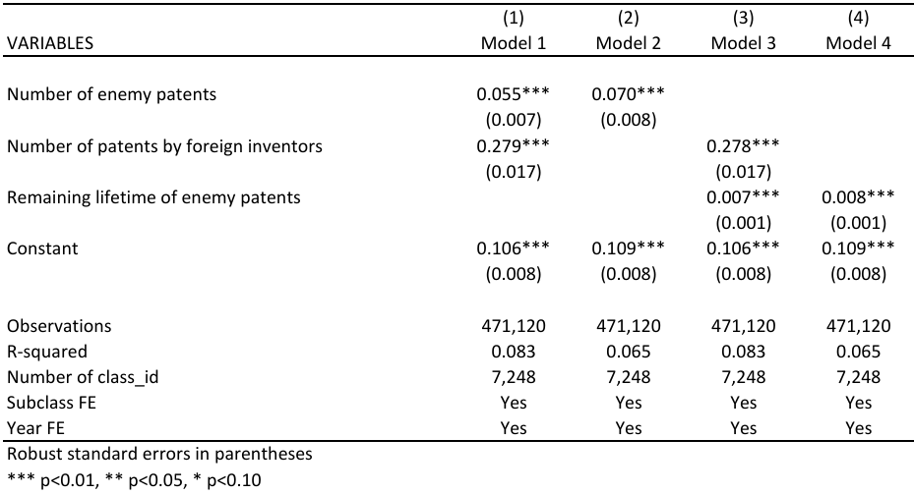
Reproduction of Results
"Push-Button" Replication Reality
The provided code was insufficient for a full replication. Specifically, the code for generating figures was missing.
•
Action Taken: We manually reconstructed all figures using Stata, extracting coefficients from TWFE models.
•
Table 3 Replication: We successfully reproduced the original findings.
Key Result: Coefficient of 0.055 (Column 1) confirms that innovation scales with the number of enemy patents.
(Replication of Author's Table 3 - Intent to Treat Regressions)

Slide 5


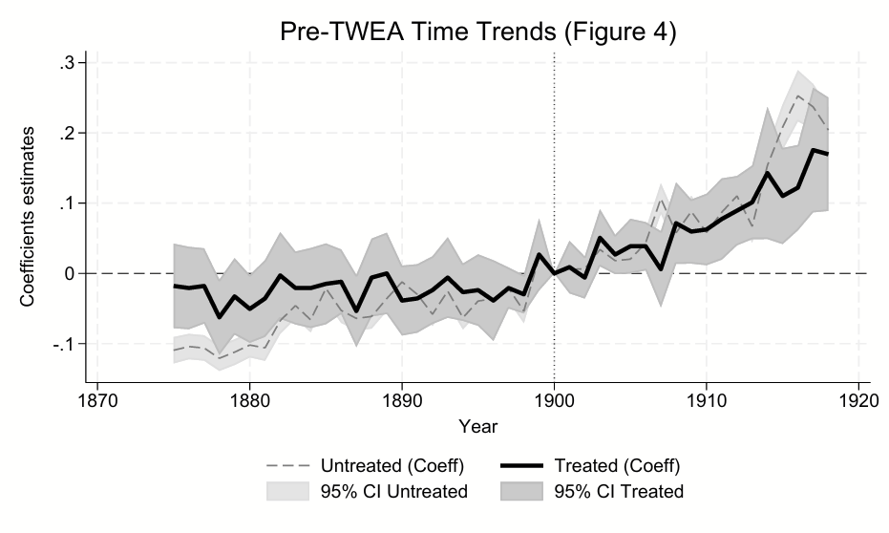
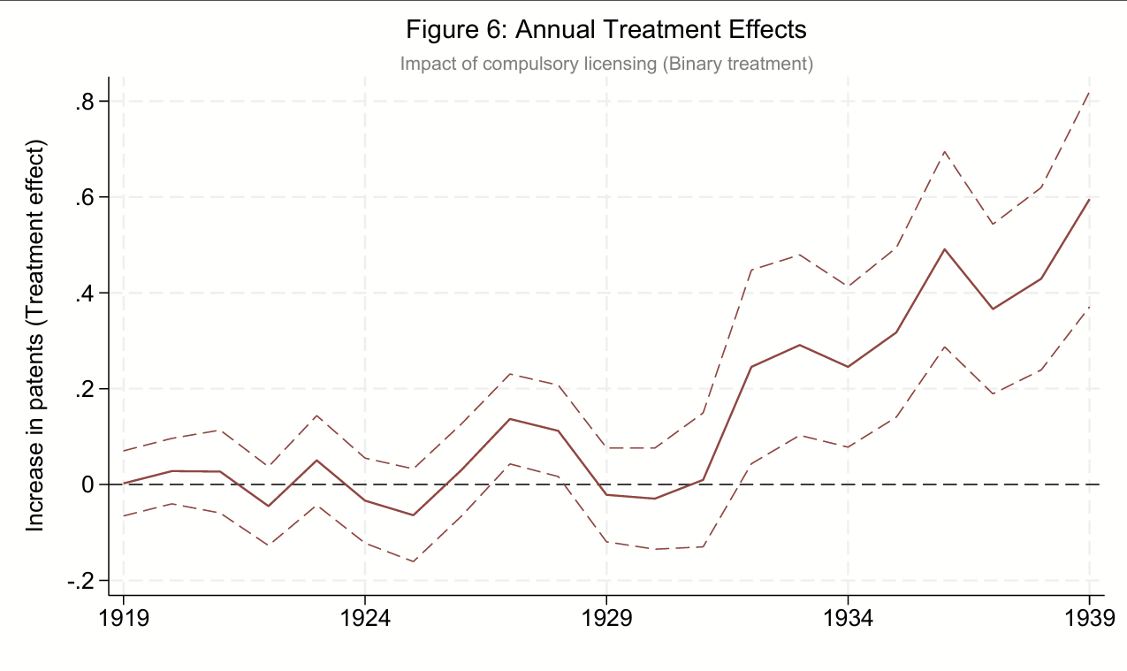
Visual Evidence: The Structural Break
Event-Study Analysis
The visual analysis confirms the validity of the empirical strategy.
•
Pre-Treatment (Pre-1918): Coefficients fluctuate around zero (Flat Trends). This validates the Parallel Trends Assumption.
•
Post-Treatment (Post-1918): A sharp, persistent structural break is visible.
•
Interpretation: The increase in domestic patenting was not a gradual artifact but a distinct shift triggered by the TWEA licensing.

Slide 6

Methodological Critique & Extensions
The Limits of TWFE
Event Study Re-Analysis
The original paper relies on Two-Way Fixed Effects (TWFE). Recent literature (Goodman-Bacon, 2021) shows TWFE can be biased if treatment effects are dynamic.
We estimated a dynamic specification (Eq 3) to capture the timeline:
•
1919-1920: Small, marginal effects.
•
1921-1926: Sharp rise and peak.
The Issue: Averaging the effect into a single coefficient (𝞫) masks the timing of innovation.
Conclusion: Results support the "Learning Hypothesis." U.S. firms needed 3-5 years to reverse-engineer German tacit knowledge.

Slide 7



Heterogeneity: Where Does CL Work?
Market Structure
Absorptive Capacity
Treatment Intensity
Finding: Impact is driven by Low Competition subclasses.
Finding: Impact is driven by High Capacity subclasses.
Finding: Inconclusive.
Lack of within-subclass variation prevented a causal interpretation of the "number of licenses" (dose-response).
CL effectively dismantled monopolies where German dominance was high, lowering entry barriers for U.S. firms.
Access to knowledge only helps if domestic firms have the prior scientific capability to understand and utilize it.

Slide 8
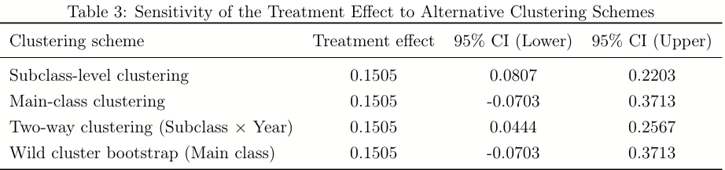
Robustness: Clustering Sensitivity
The Clustering Problem
Our Re-Analysis
We re-clustered at the Main Class Level (N=19).
The original paper clustered standard errors at the Subclass Level (N=7,248). However, technologies are correlated within broader fields.
•
Result: Standard errors increased by ~1.5x.
•
Significance: P-value increased from <0.001 to 0.04.
Conclusion: The result is robust but statistically "fragile." The original certainty was overstated.

Slide 9

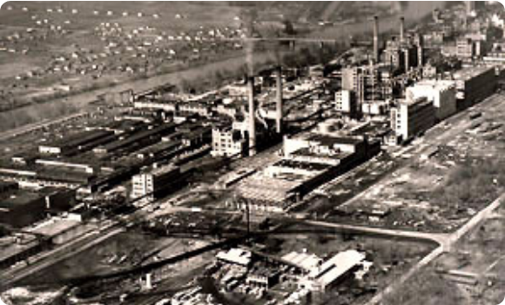
Mechanisms & Intermediary Outcomes
How did the policy work?
We analyzed intermediate channels to explain the surge in patenting:
•
Stock of Licensed Patents: Significant increase in treated subclasses. The policy successfully reallocated IP rights.
•
Patent Quality (Lifetime): Licensed patents had longer remaining lifetimes. U.S. firms targeted economically valuable, active technologies, not expiring ones.
This confirms CL worked by improving access to active and relevant foreign technology.

Slide 10
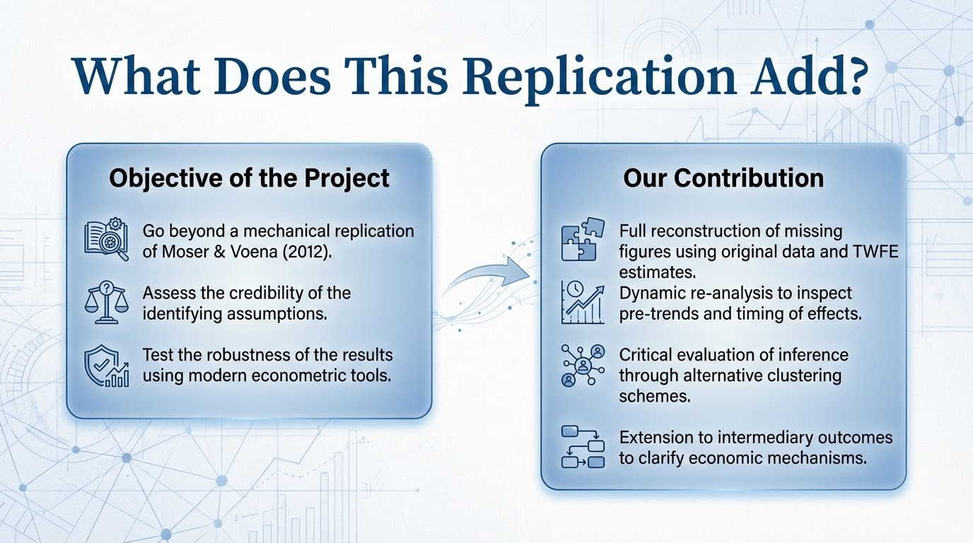

Slide 11
Conclusion
Internal Validity Confirmed: Moser & Voena's core finding holds. CL increased U.S. innovation.
Nuance Added: The effect is dynamic (3-5 year learning lag) and heterogeneous (works best against monopolies).
Caution: Statistical significance is sensitive to clustering choices.
"Compulsory licensing effectively dismantled foreign monopolies, but required local absorptive capacity to succeed."

